Slide 1


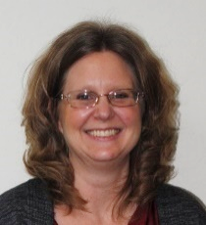
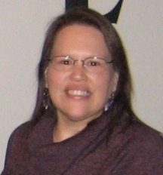
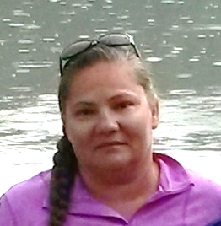
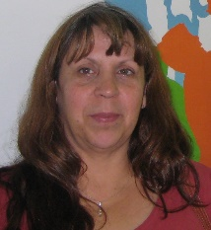
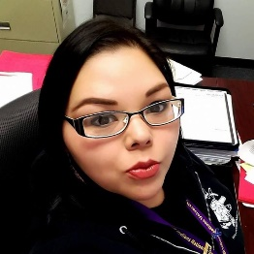

Lac Courte Oreilles (LCO)
Mino Maajisewin (A Good Beginning)
Home Visitation Program
1998 – Tribe received POCAN funding
2011 to present – Awarded Family Foundations Comprehensive Home Visitation Grant
Jenny A. Bisonette
Program Coordinator
Day-to-day Supervisor
Mary F. Tribble
Grant Manager
Quality Improvement Lead
OUR TEAM!
Vacant
Barb Baker-LaRush
Doula/Outreach Worker
Melody Guibord
Home Visitor
Tibissum Rice
Home Visitor
Open Position
Home Visitor

Slide 2
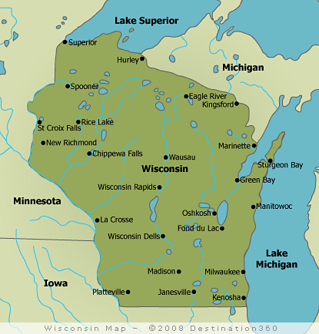
Lac Courte Oreilles (LCO)
Mino Maajisewin (A Good Beginning)
Home Visitation Program
Part of Family Foundations Home Visiting (FFHV) network in the State of Wisconsin
31 Local Implementing Agencies
31 Counties and 5 Tribes
LCO is one of five Tribal Programs in the state
What is Mino Maajisewin?
Voluntary, intensive, and long-term home visitation services
Focus on supporting parent-child interaction


Slide 3
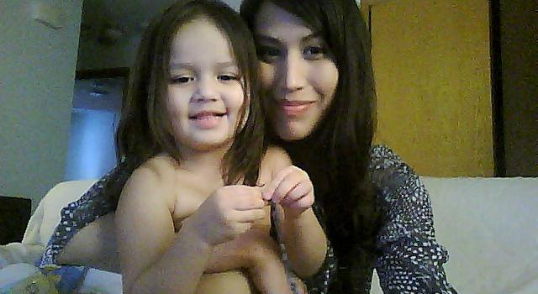
The families we serve...
Currently serving 28 enrolled families
Member of a Federally Recognized Tribe residing in Sawyer County
First-time parent, both mothers and fathers
Family is enrolled during pregnancy or within 3 months of birth
Assess for certain risk factors
Reoccurring themes:
- History of childhood trauma
- History of substance use
- Lack of positive peer relationships/social support
- Poverty
Approximately 50% of moms screen positive for depression
32% of participants have 5 plus ACES (2017 Data)

Slide 4
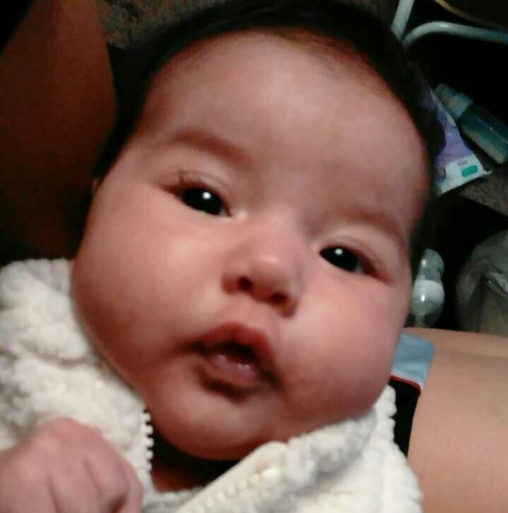
How we serve….
Relationship with the family, focusing on strengths and needs
Voluntary services
Screening/assessments tools
Information for a healthy pregnancy
Financial support
Meeting the family where they are at (family decides)
Promoting parent child interaction
Family Goal Planning
Information on developmental milestones
Connecting families to appropriate resources and follow-up
Home Visitor Training
Growing up in a safe home, where I feel loved and my needs are met.
Mom and dad are able to read my cues.
They know how to respond to my needs in a loving and nurturing way.
Weekly supervisory session and reflective practice
Support during labor and delivery
Weekly home visits

Slide 5

Lac Courte Oreilles (LCO)
Mino Maajisewin (A Good Beginning)
Home Visitation Program
Strengthening Our Breastfeeding Efforts
Participation in Breastfeeding: The Traditional Way and the Native Breastfeeding Coalition since the start of these initiatives.
Part of a CQI project that focused on increasing breastfeeding rates among program participants.
  Provided additional BF education to HV staff
  More focused conversations around BF during pregnancy
  Revised Birth Plan to include Infant Feeding Plan
  Increased support during hospital stay and two weeks postpartum
Increase in the number of women who initiate and maintain breastfeeding among program participants and the community at large!!

Slide 6

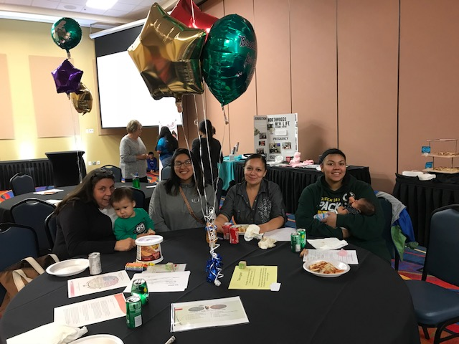
Lac Courte Oreilles (LCO)
Mino Maajisewin (A Good Beginning)
Home Visitation Program
Moving into the Community
Mino Maajisewin Outreach Worker/Doula partnered with staff from Hayward Area Memorial Hospital to provide birthing classes and breastfeeding support groups in Spring of 2018.
Breastfeeding Community Event in August 2018
  Invited partner agencies to attend and have displays
Larger coalition provided anchor for local activities
  Access to additional resources/culturally appropriate materials
  Helpful to hear what other tribal sites were doing
  Kept us accountable for moving forward (What are we going to report out on at the next coalition meeting?)

Slide 7

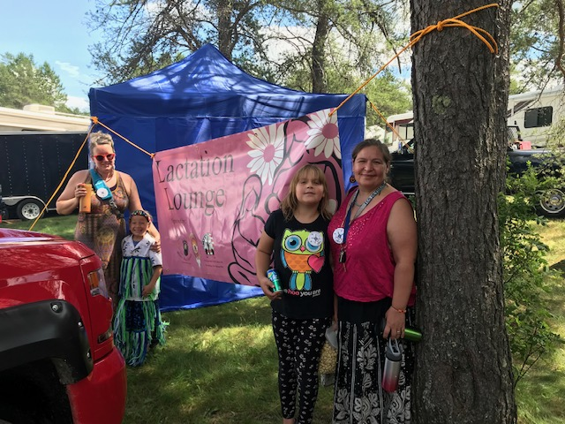
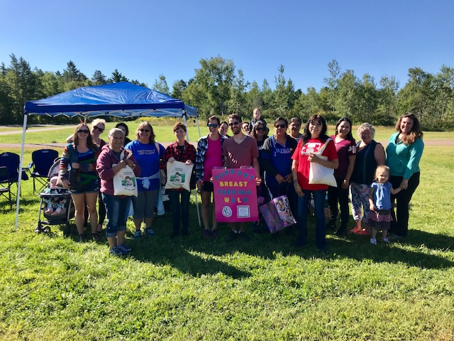
Lac Courte Oreilles (LCO)
Mino Maajisewin (A Good Beginning)
Home Visitation Program
  Gathering Support
Started monthly BF coalition meetings within LCO Community in December 2018
  LCO Head Start, LCO FACE Program, Hayward Hospital, Mino Maajisewin, LCO Health Center, LCO Birth to Three Program
Resolution passed by the LCO Tribal Government in January 2019 that supports women to breastfeed in public places
  Lactation Lounge at the Honor the Earth Pow Wow
                July 2019
                Breastfeeding Walk to celebrate National Breastfeeding Awareness Month
                August 2019

Slide 8
Lac Courte Oreilles (LCO)
Mino Maajisewin (A Good Beginning)
Home Visitation Program
  Next Steps
  Initial conversations about how to move forward with Breastfeeding Friendly Worksite Efforts at LCO
    Where we are at now:
      Start with low hanging fruit
      Positive Momentum – what better time to work on this?
    Obstacles:
      Space at existing facilities
      Additional workload – who/what agency is able to take this on?
        Time and energy demands

