Slide 1


Native Breastfeeding Coalition of Wisconsin

Slide 2
History
Established in 2016
Advisory committee for grant program Breastfeeding: The Traditional Way
Low breastfeeding duration rates in Tribal Communities in Wisconsin

Slide 3
Mission Statement:
Vision Statement:
Strengthen and encourage the traditional practice of breastfeeding to improve the lives of women, babies, and families, for generations to come.
Native Communities support breastmilk as the first food to nourish our mind, body, and spirit.

Slide 4

BTW Summary
Program Goal: Increase breastfeeding duration rates over 3 year project span
Program Objectives:
  Increase the number of infants breastfed for 6 months by 6%
  Increase the number of infants breastfed for 1 year by 2%
Program Initiatives:
Professional/paraprofessional Lactation Education (CLS)
Community Breastfeeding Education
Peer Breastfeeding Support/Support Groups
Business Friendly Breastfeeding Support
Culturally appropriate materials/media

Slide 5
Healthy Wisconsin Leadership Institute-Community Teams Program
Gain skills in engaging the community, determining root causes and issues, creating sustainability plan, build strong multi-sector partnerships
Communicating our message with 27-9-3 statements
Develop value proposition and coalition charter
Tell our story (in progress)
https://www.youtube.com/watch?v=os-YFzDYmzM

Slide 6
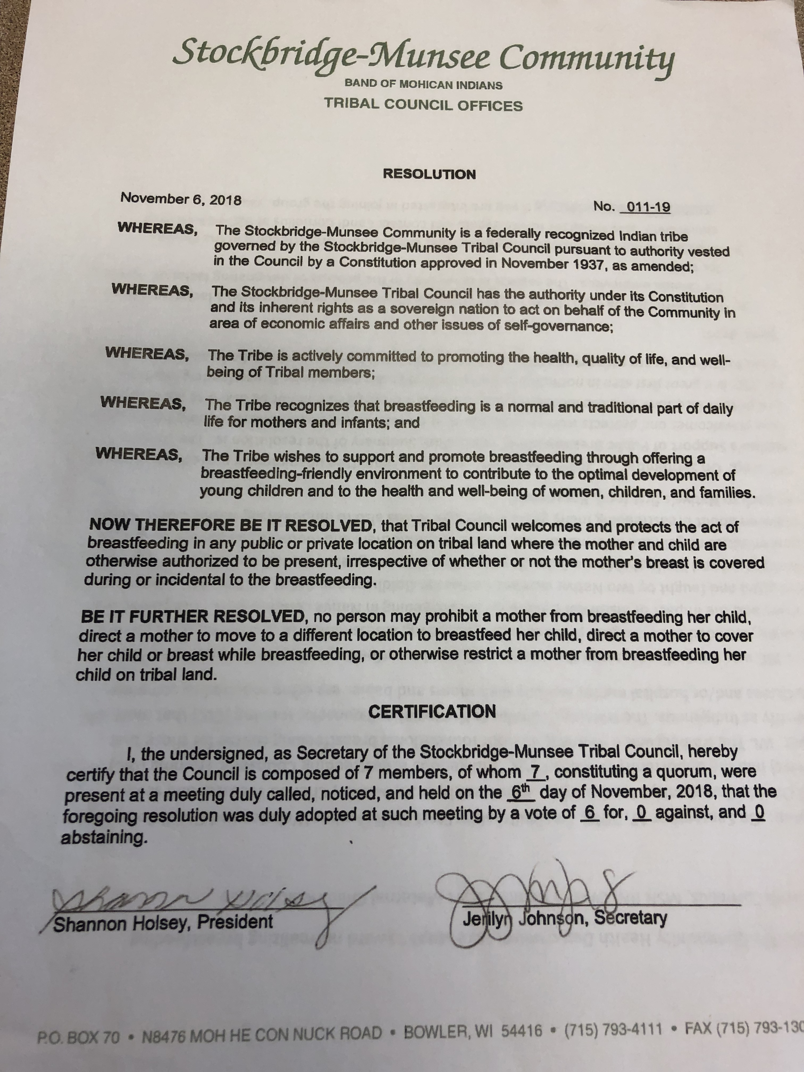
Tribal Resolution
Passed in 3 tribes!
Identified tribal resolution as action plan
Goal to present in 3 tribes by Dec. 2019
Goal to pass in 1 tribe by Dec. 2019
Created toolkit including letter of support, template presentation of issue,handouts, and resolution templates

Slide 7
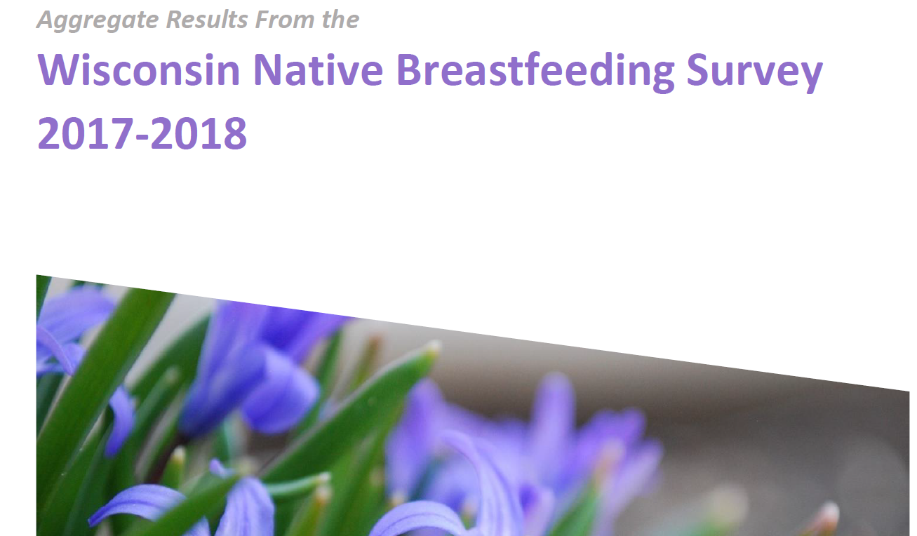
Breastfeeding Survey
218 valid surveys-represented 7-8% of actual births of Native children
90% breastfed at least once
21% offered formula at birth
37.8% breastfed for 6 month or longer
50% had help from a lactation consultant
One-fifth reported using traditional medicines/herbal remedies
Milk supply reported as top reason for deciding to stop breastfeeding

Slide 8
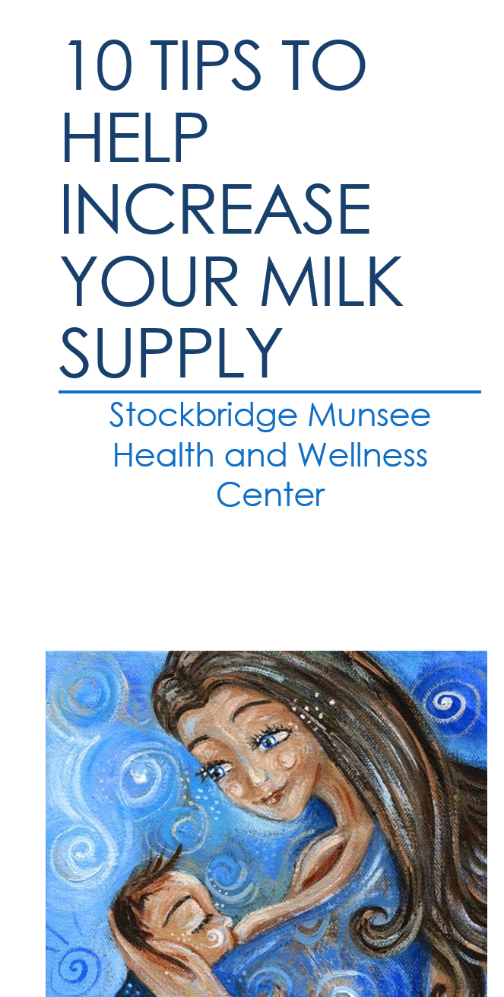
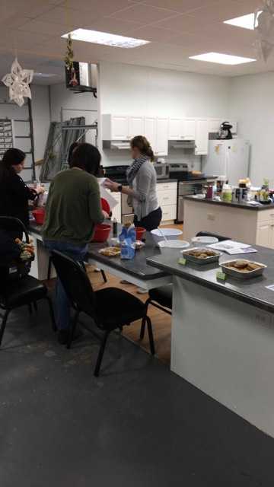
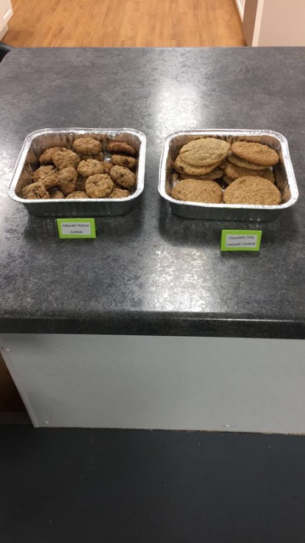
Community Education Events
Notes:
Community Education events were a large part of our objectives. We wanted to reach across the community in our education.
Some tribes went all out!
A total of 41 education sessions in 9 tribes
Baby wearing, bf walks, lactation cookie take and bake,
Created lesson plans for staff to use, included Elders and Fathers when able,
Picture taking

Slide 9

Breastfeeding Support at Public Events
Pow wows, health fairs, ceremonies
Provide assistance to purchase tents, fans, chairs, changing station

Slide 10
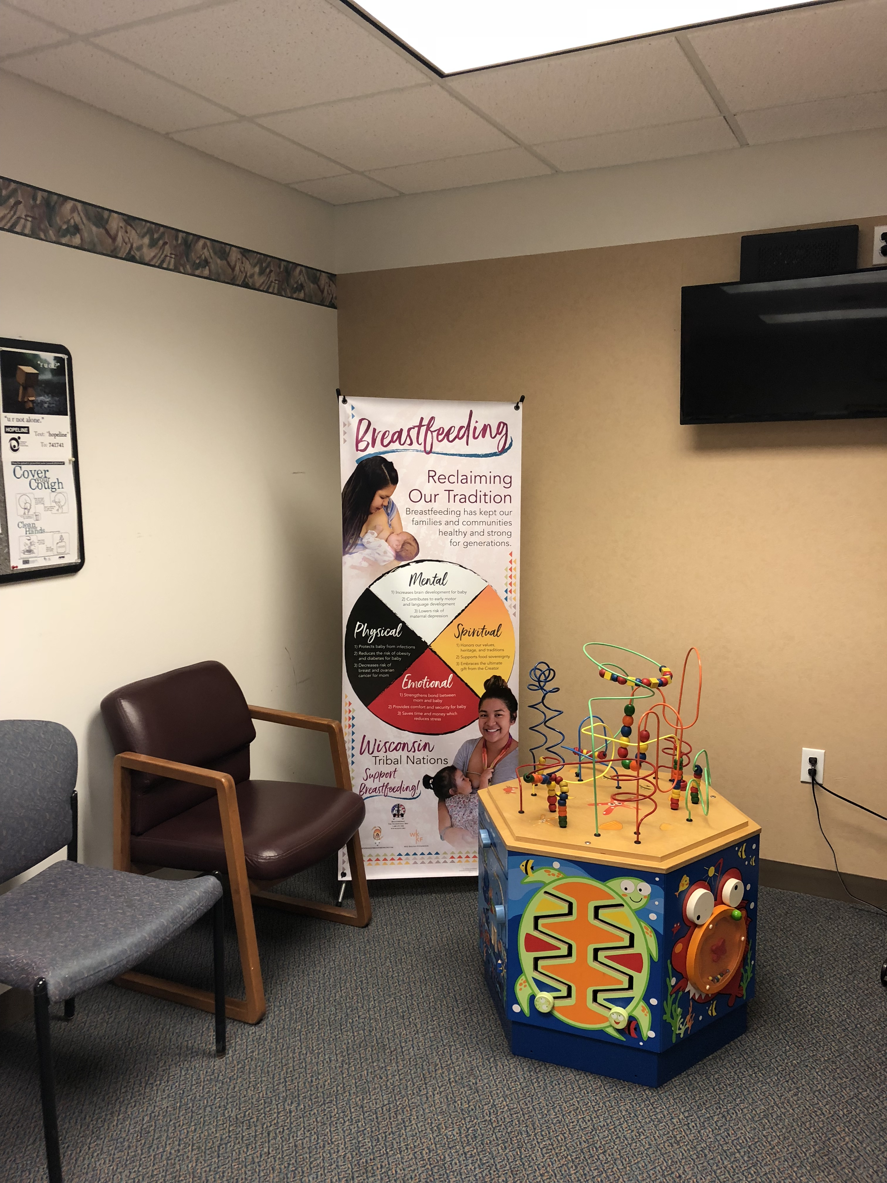
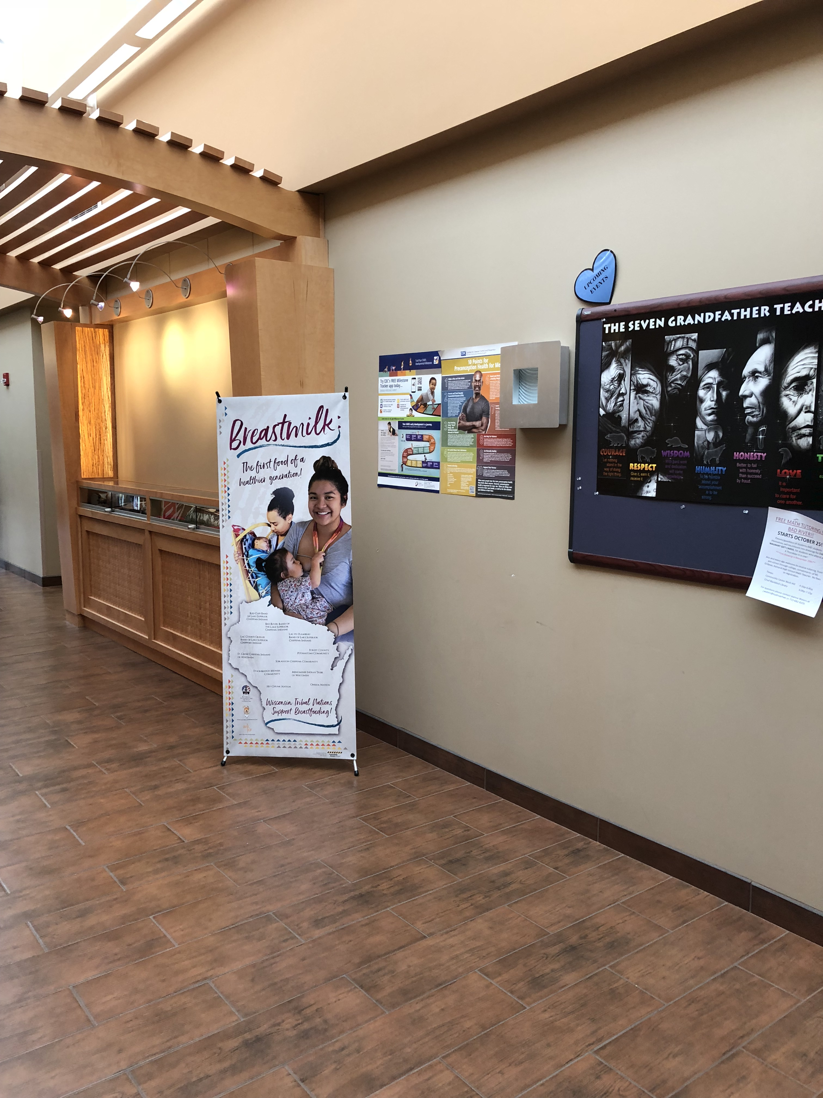
Native Specific Materials

Slide 11
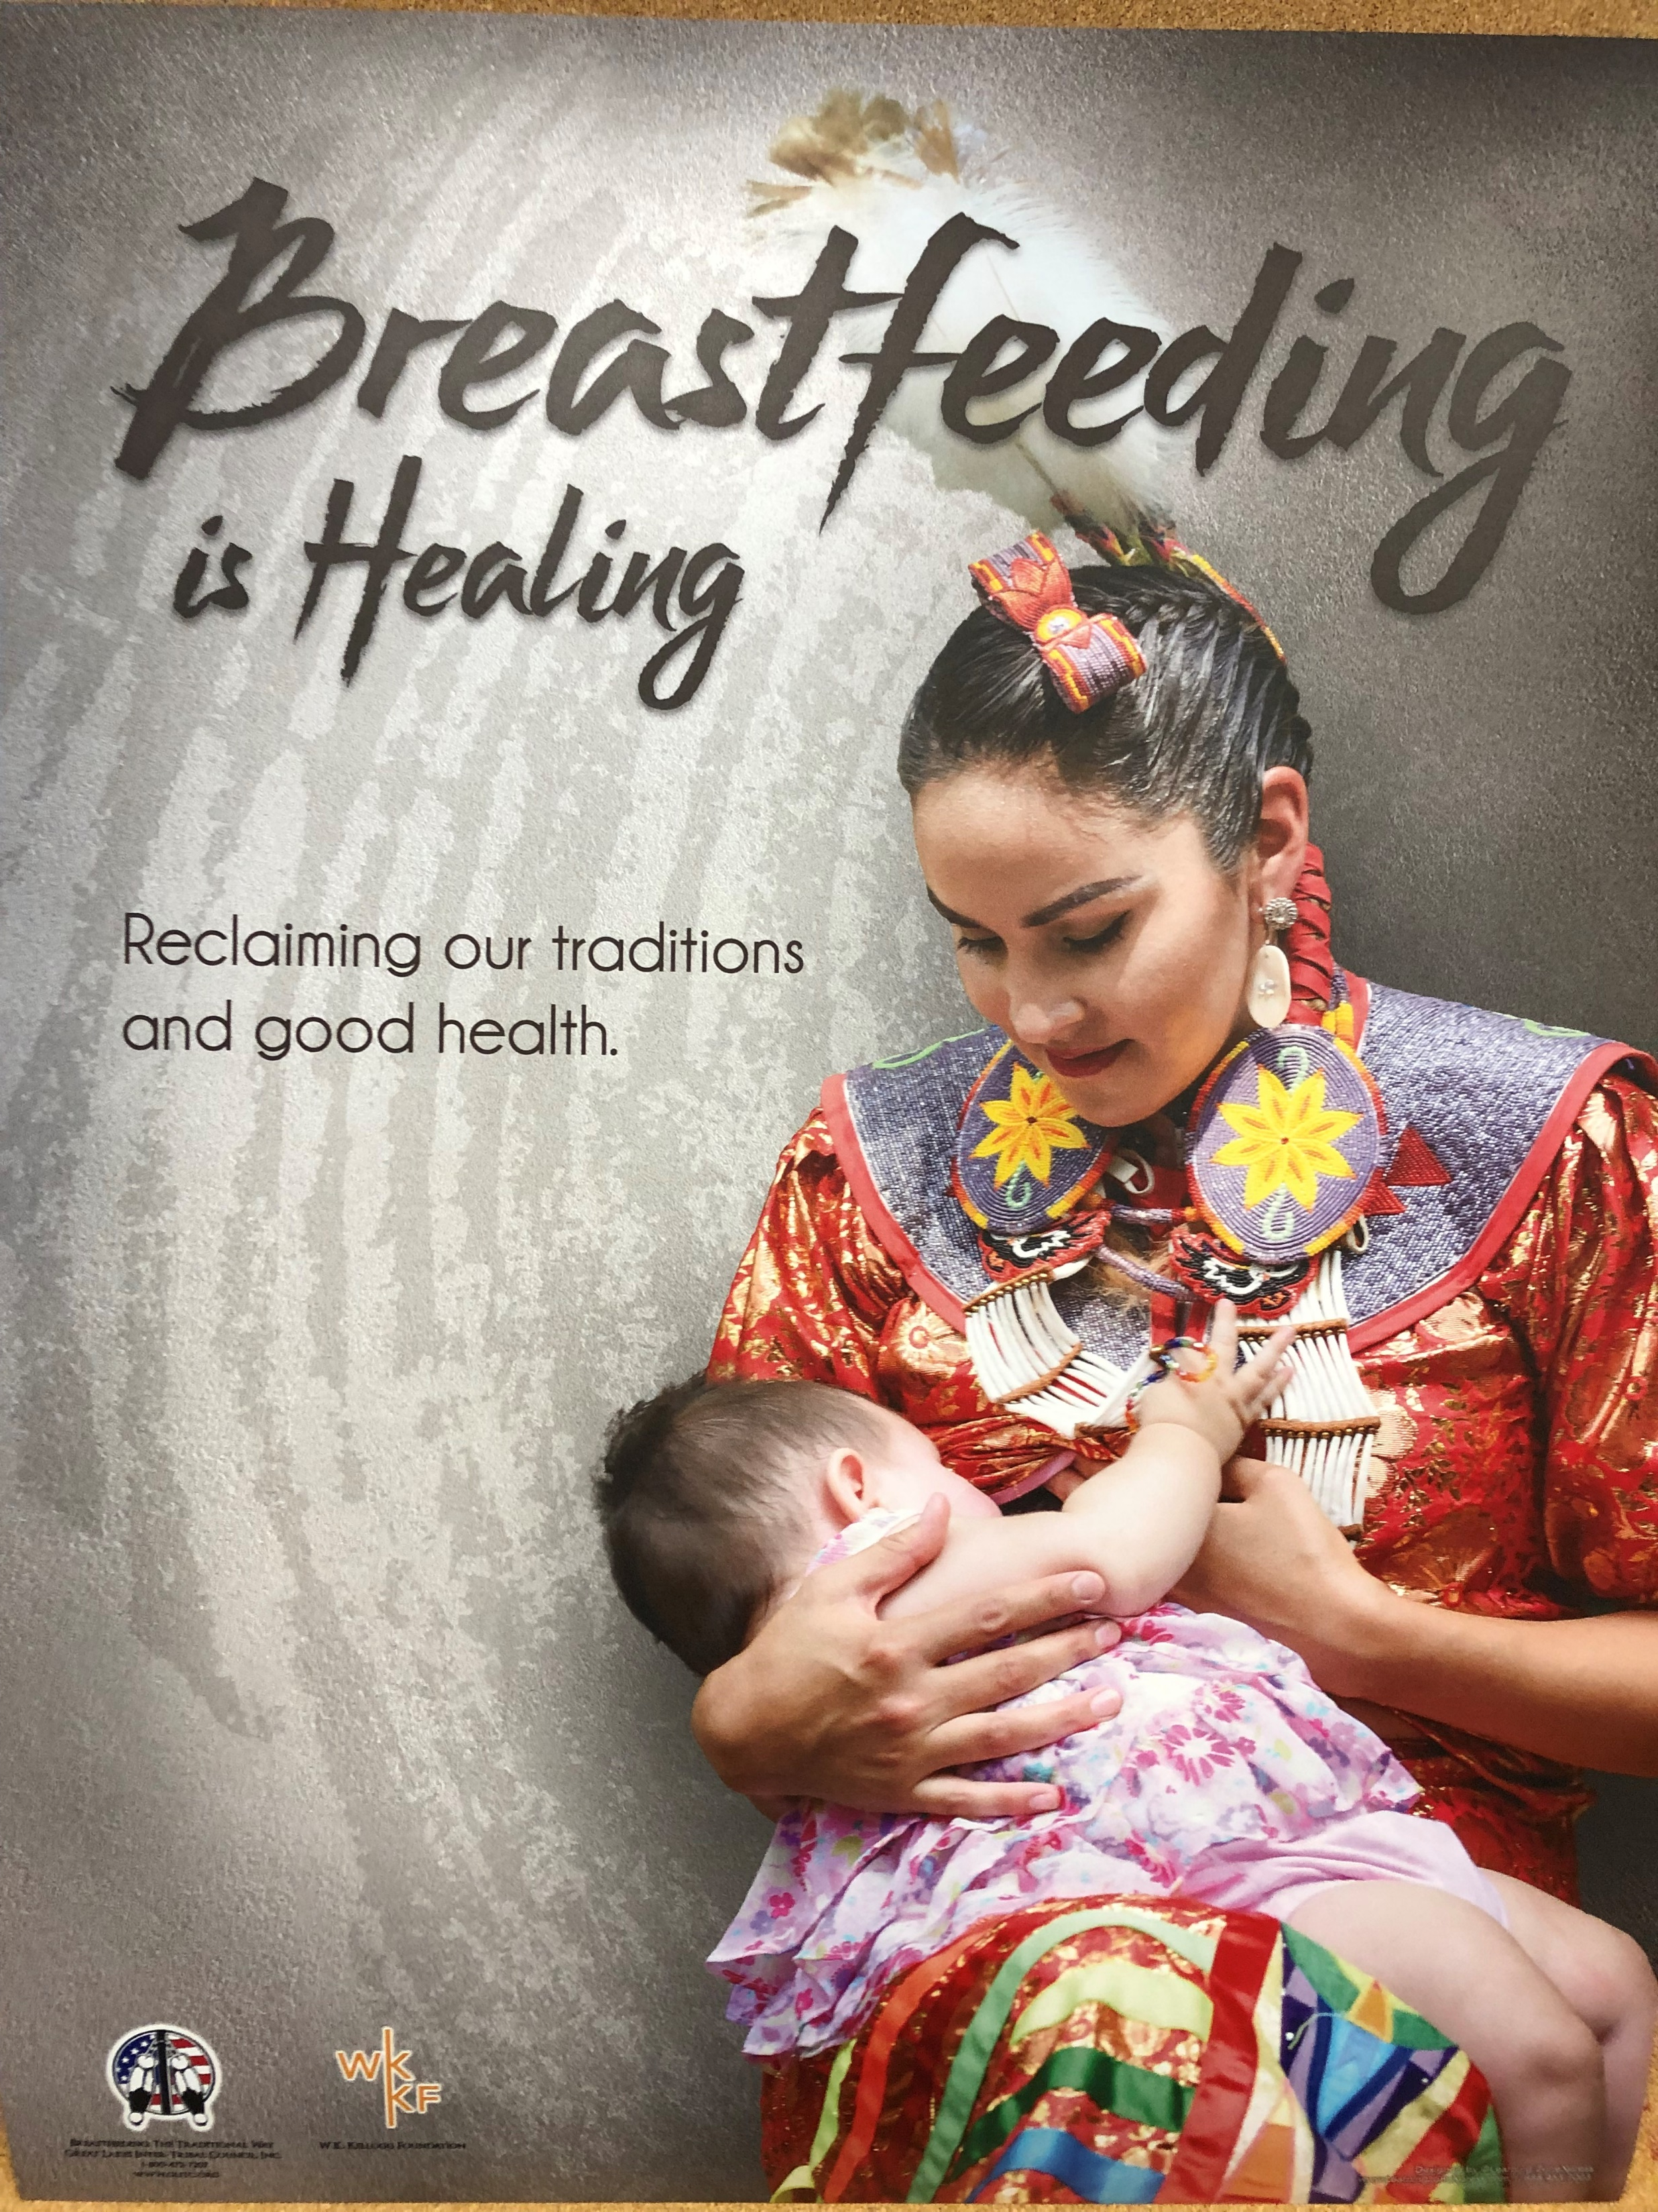
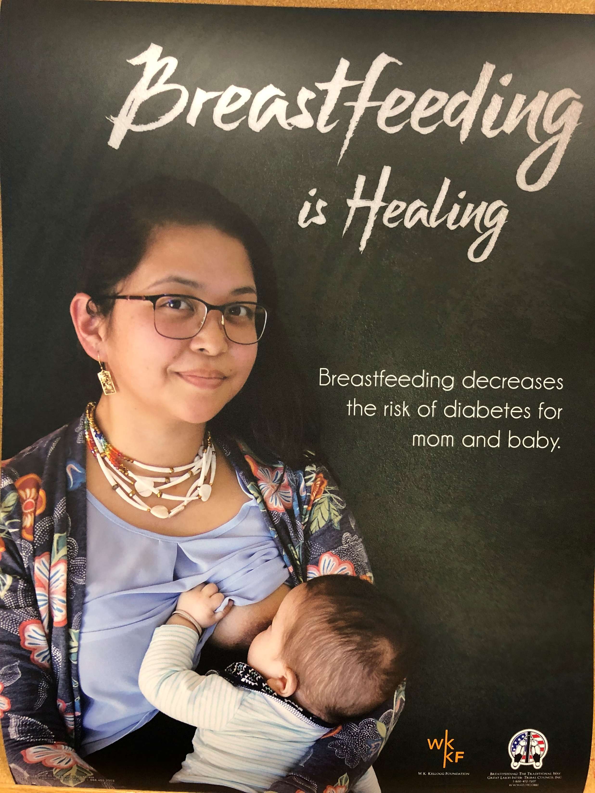
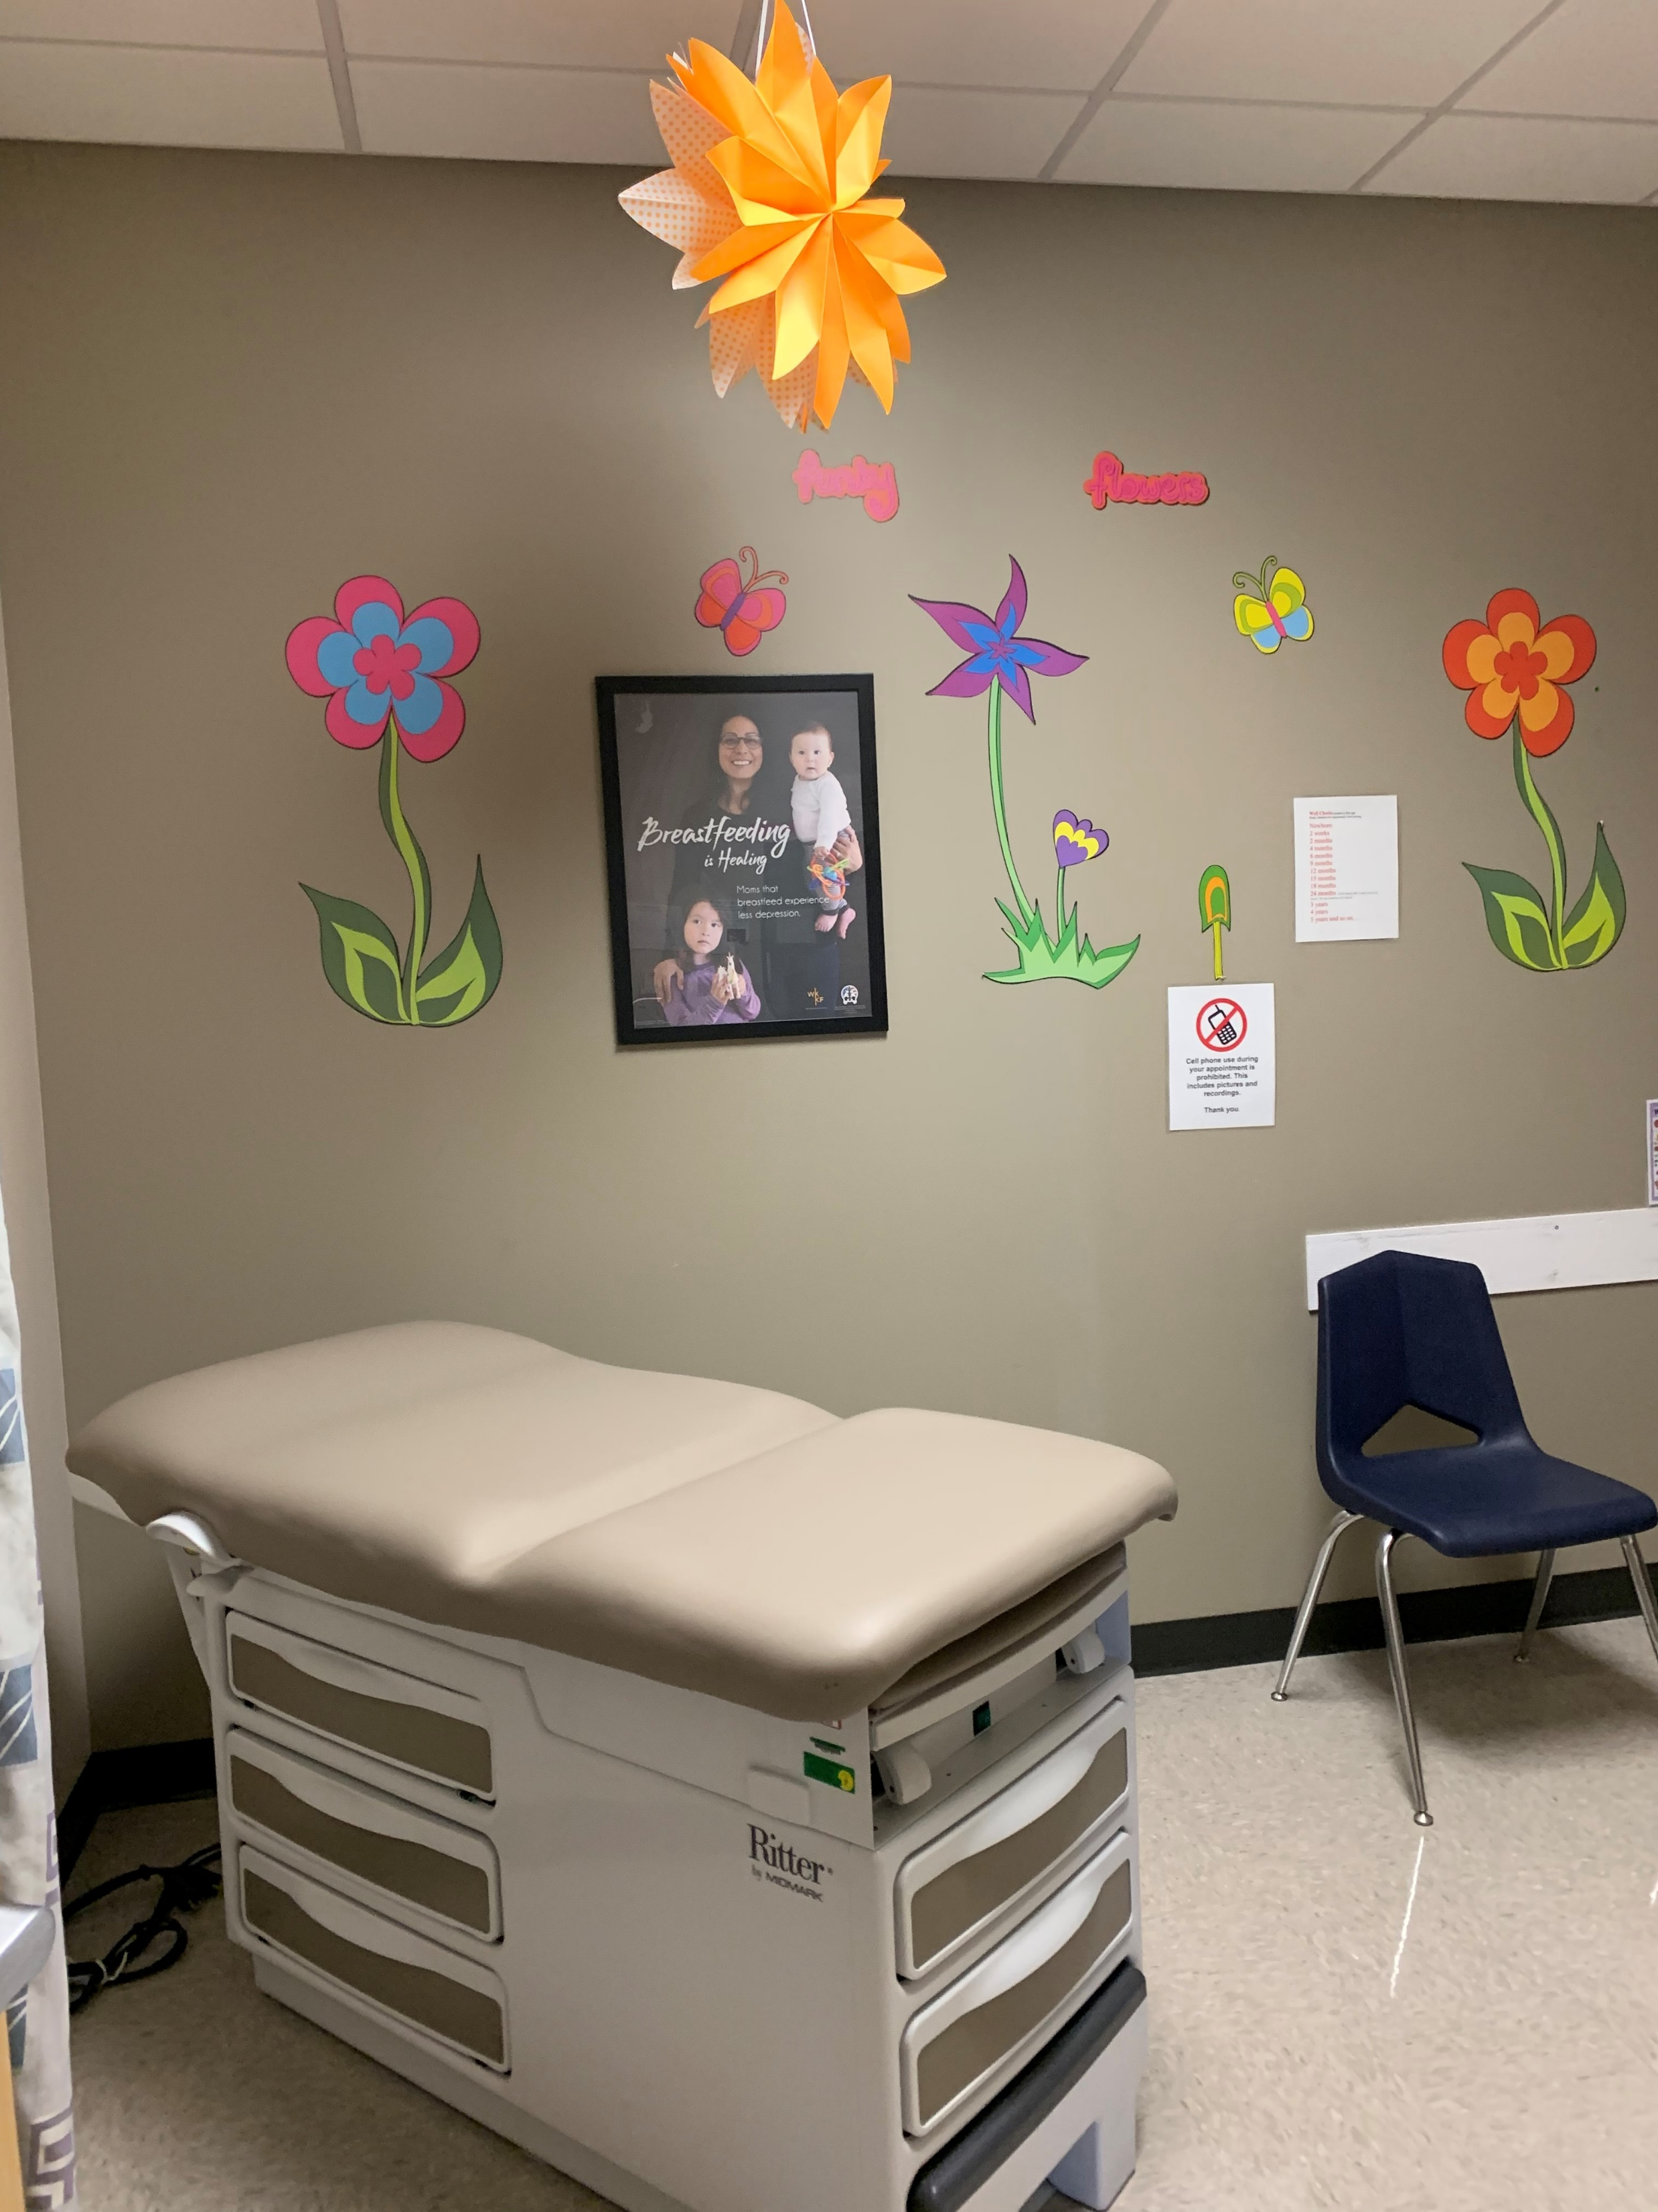
Breastfeeding is Healing
Notes:
Describe poster series
Locations posted: health clinics, head-start, library

Slide 12
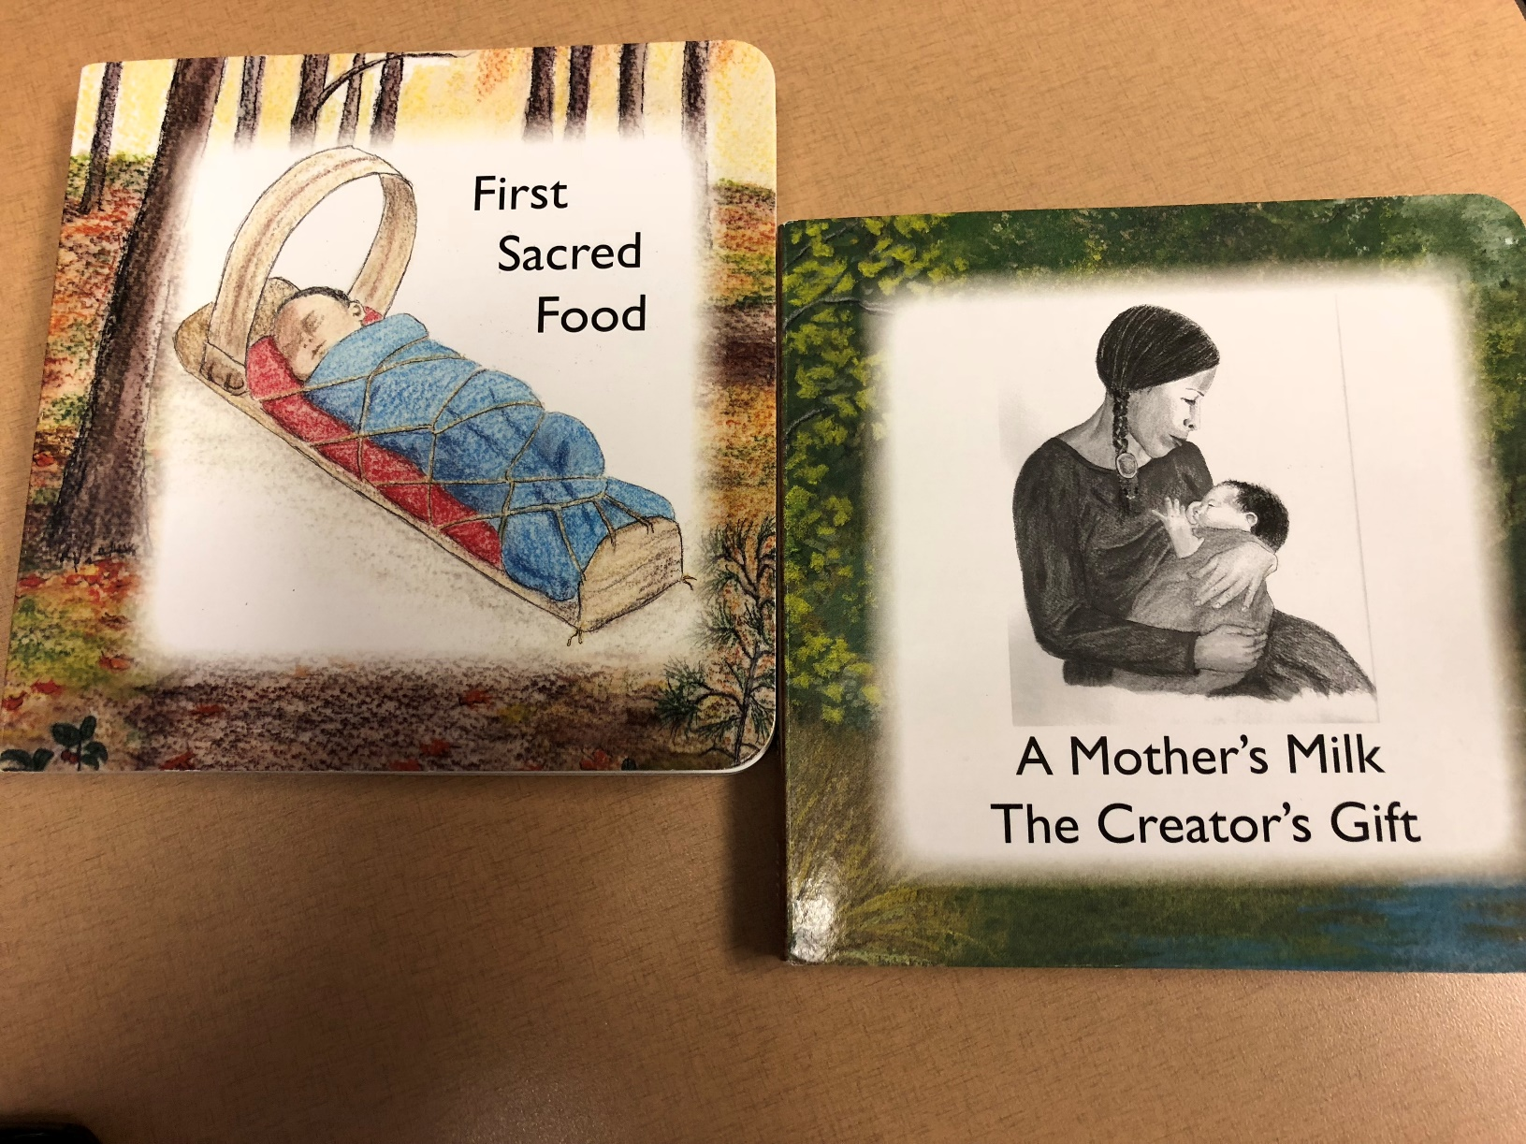
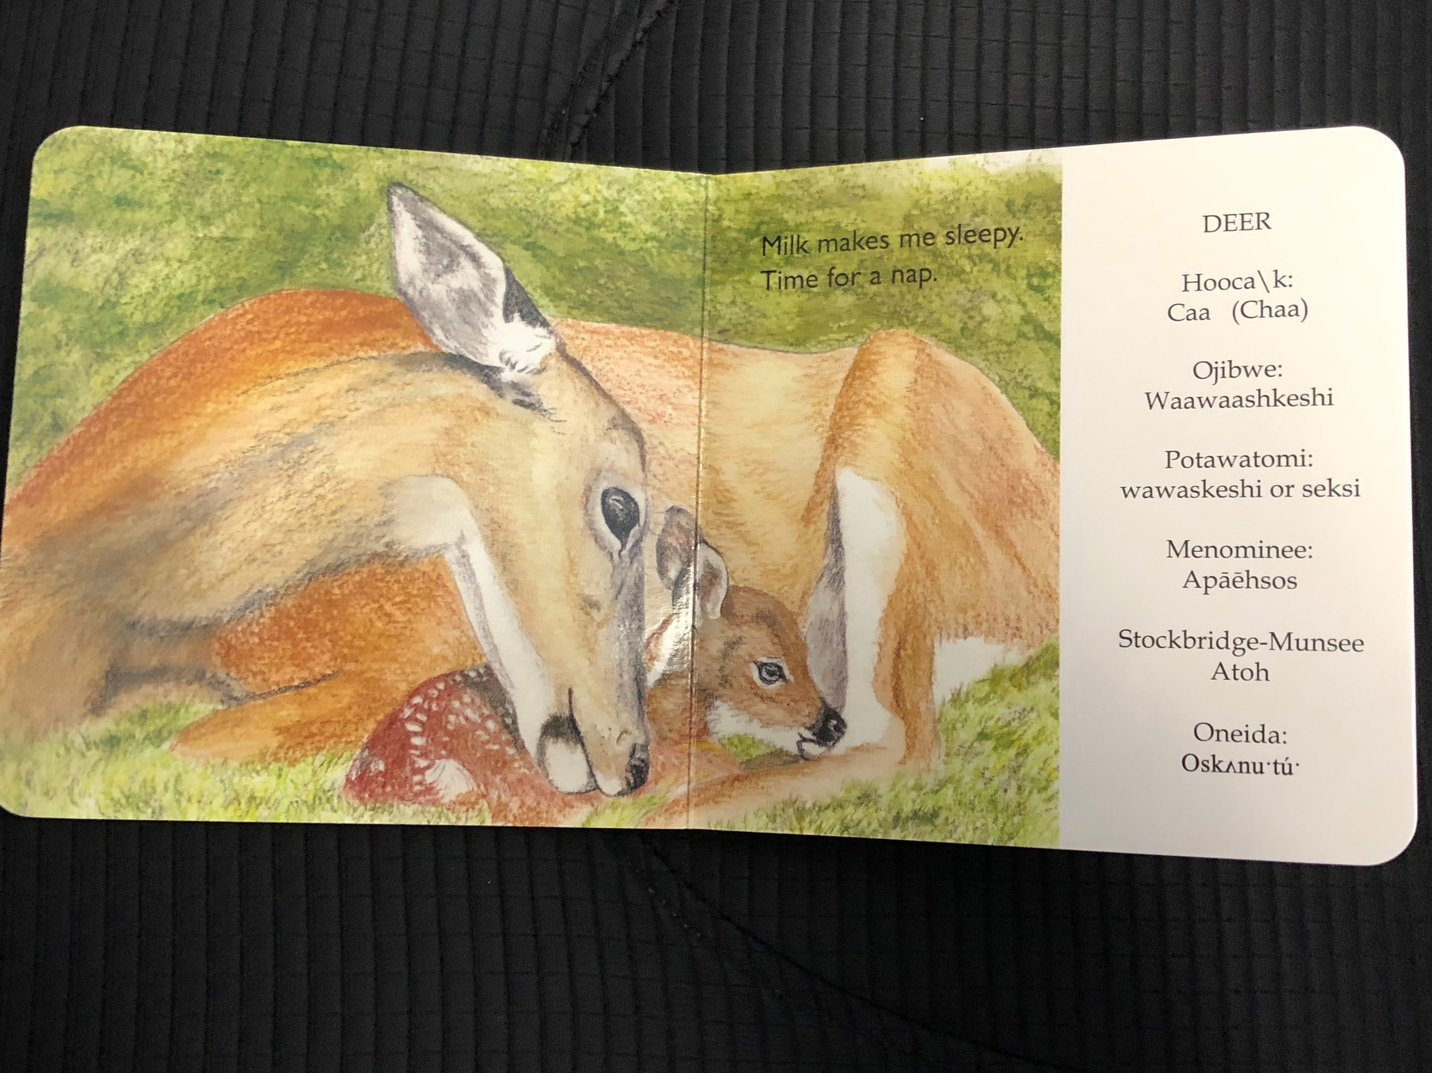

Slide 13
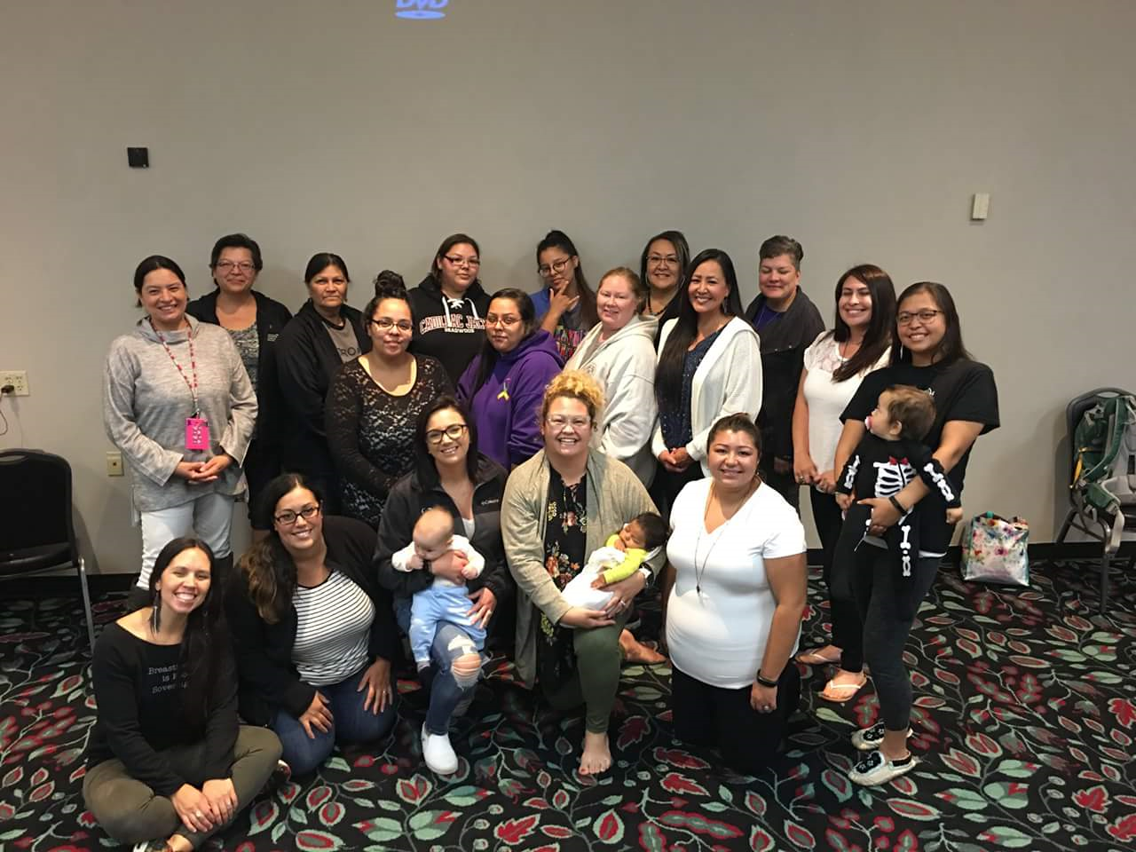
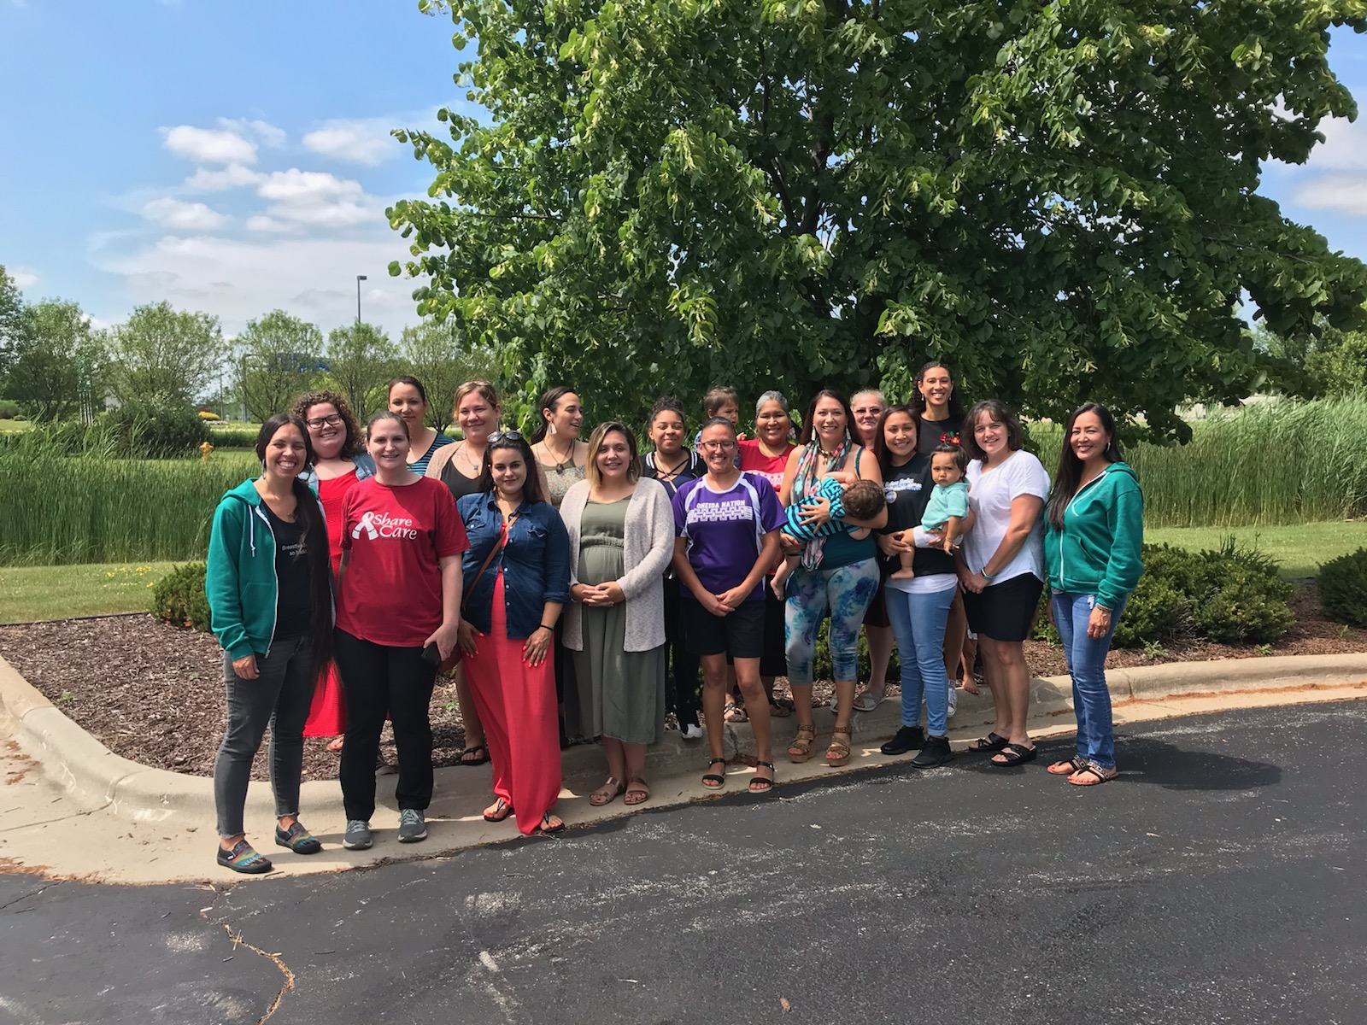

Indigenous Breastfeeding Counselor Training
Notes:
Education to provide community support
Within the first year, provided the CLS training to 44 providers in areas serving tribal communities.
Then the IBC training was developed by Camie Goldhammer and Kim Moore Salas. The first training was offered in September of 2018 and had great response and members kept asking for more! In cooperation with a few other programs and support from our host tribe, Oneida Nation, we were able to schedule a second session that will be held this July.

Slide 14
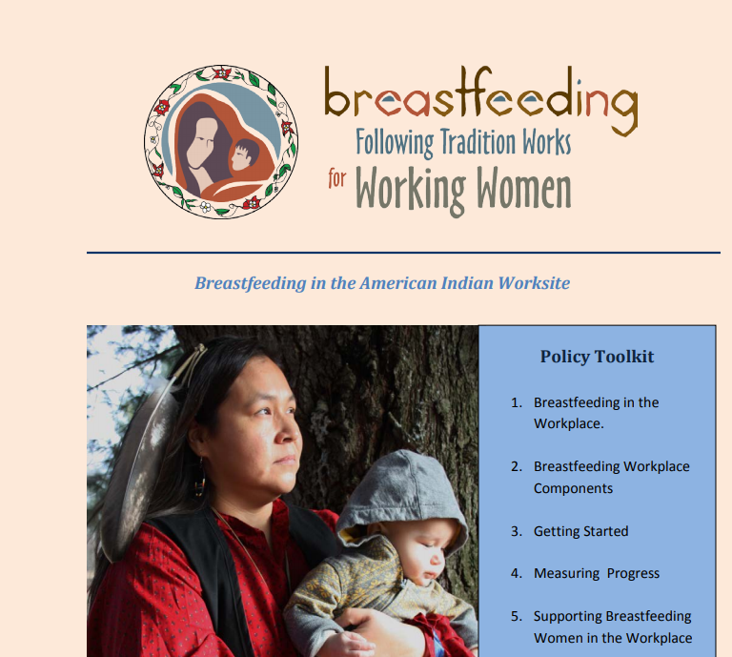

Breastfeeding Friendly Worksite Efforts
Offered funding for lactation spaces
Develop training materials for worksites
Policy development for tribal entities
Acknowledge breastfeeding friendly worksites
Coalition support for policy efforts

Slide 15
BTW Outcomes
44 trained tribal staff (CLS)
Community education events at 10 tribal sites including development of peer support groups
Creation of Native Breastfeeding Coalition of Wisconsin
Breastfeeding Survey
Community Teams Program (Healthy WI Leadership Institute)
Created tribal resolution toolkit
Material development

Slide 16
Breastfeeding Duration Rates
Duration | April 2016 | April 2019
BF at 1 month | 73.8% | 77.1%
BF at 3 months | 65.2% | 67.1%
BF at 6 months | 36.7% | 37.3%
BF at 1 Year | 15.3% | 18.5%
WIC Breastfeeding Rates by Race/Ethnicity (American Indian/Alaska Native)

Slide 17
Best Practices
Community and family based education
  Include fathers
  Include grandmothers/Elders
Education that includes addressing barriers and providing realistic view of breastfeeding
Peer to peer support groups
Educate non-reservation providers about BF resources in tribal communities
Appropriate materials and discussion of traditional practices and medicines
Notes:
Describe what BTW has learned as far as best practices for BF education and support in tribal communities.

Slide 18
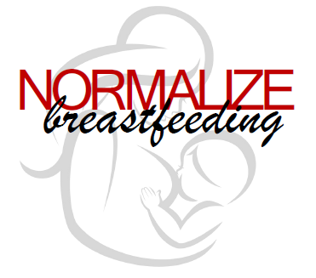
Future Plans
Sustainability plan for Native BF Coalition of Wisconsin
Sustainability plan for breastfeeding support groups
Be a voice for food sovereignty and first foods discussions
Digital Storytelling
Support tribal resolution development and presentation in remaining tribes
Plan for business support for breastfeeding
Secure additional funding!

Slide 19
Contact Us!
https://www.nativebreastfeedingwi.com/
On Facebook and Twitter!
https://twitter.com/NBCofWisconsin
https://www.facebook.com/NativeBreastfeedingCoalitionofWisconsin/
Cheri Nemec, RDN, CD, CLS, IBC
Great Lakes Inter-Tribal Council, Inc.
Lac du Flambeau, WI
www.glitc.org
cnemec@glitc.org
715-588-1020
Candi Cornelius, MSN, RN- Prenatal Care Coordinator
Oneida Comprehensive Health Division
Community Health Nursing • Population Based Programming
office: 920.869.4940
Oneida, WI 54155
www.oneida-nsn.gov
Jenny Bisonette, MSSW
Program Coordinator
Mino Maajisewin Home Visitation Program
Hayward, WI 54843
715-558-7734 (direct line)
jenny.bisonette@lco-nsn.gov

